Slide 1
SP20-042 Impact of an Explicit Health Benefit Plan on Support for Universal Health Care
A Masters Thesis Proposal by: Sean X. Duan

Slide 2
Why this project?
Health Care in the U.S. is broken
Universal Health Care has benefited other countries
Drug costs out of control
Medical care is being provided with insufficient evidence as to it’s value
Arbitrary variation on healthcare provided
Prior to the Affordable Care Act, medical costs were the most common cause of bankruptcy (Galvani et al 2017)
OECD countries with UHC spend less on healthcare and have superior outcomes
Universal Health Care improves country bargaining power for drugs
UHC leads to immense improvements in proportion of population insured

Slide 3
Why this project?
Opposition to UHC in the U.S.
Explicit Health Benefit Plan solves these issues.
UHC is complex and varied
UHC is difficult to define easily
US citizens want a system that is
Fair
Equitable
Transparent
Understandable
Creates explicit entitlements for patients (understandable)
Helps to identify if funds are being spent wisely (equitable)
Improves adherence to budget limits based on clear criteria (transparent)

Slide 4
Method: Materials
CHAT exercise (Danis, Biddle, & Goold)
Web-exercise version
Printed ‘Detail’ sheet acts as legend
“5 minute” minimum time
‘Traditional’ UHC information
Pamphlets from WHO
3 Pamphlets
“90 second” minimum viewing time

Slide 5
Method: Measures
Pre-Test
Support for Universal Health Care (Shen & Labouff)
4 items, taken as an average
Sliding scale: 0(strongly disagree) – 100(strongly agree)
Post-Test
Second measure of Support for UHC
Demographic Information (sex, age, schoolyear)
Qualitative response: Feelings about activity
Likelihood to want UHC plan
1(strongly disagree) – 7 (strongly agree) likert scale
Pay for Insurance (Y/N)
Have ever been uninsured (Y/N)

Slide 6
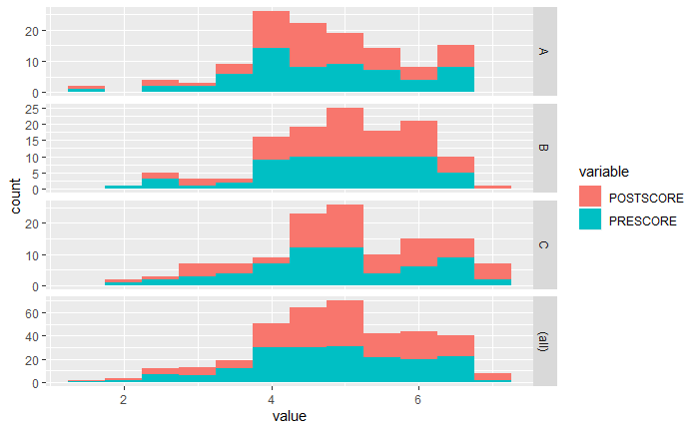

Slide 7
Suggestions from Ken Sheldon
Overall likes everything
Measure Moderating Factors?
Take these scores pre and post intervention
“Complexity/Difficulty Understanding” UHC
Perceived “Equity/Fairness” of UHC
No validated domain specific measure
Advertising
Industrial/Organizational

Slide 8
Method: Design
2x2 between subjects design
Multi level model
Time of measurement nested w/in subject
Independent variable
Time of measurement (pre/post intervention)
Experimental condition (control/HBP exercise)

Slide 9
Method: Procedure
Cubicle with Qualtrics survey
Pre-test measures given
Randomization
Control
3 UHC infographics – 90 sec minimum each
Intervention
Facilitator sets up/provides printed material
HBP activity in separate screen – 120 sec minimum
Printed HBP ‘legend’
Post-test measures given
Debrief

Slide 10
Method: Modelling
Multi-level model
Time nested within Subject
Comparisons
Condition > Support UHC
Time x Condition > Support UHC
Condition > Moderating factors?
Moderating factors > Support UHC?
Variable Selection
Forward Selection
Stepwise Selection

Slide 11
Limitations
College Students
Not reflective of insurance buyers
Cannot effect change on UHC directly
Exercise too complex
How do people access UHC information?
Infographics??
Physicians for National Health Plan??
“Word of Mouth”??

